Slide 1

CMPE-256 Summer 2019 - Group 10
Mario Yepez
Zaid Laffta
Kunj Parikh
Srinivasa Prasad Sunnapu
Miguel Covarrubias

Slide 2
Motivation: Why Spotify? Why Playlists?
This project falls under “An App or Website to perform brainstorming, ranking or proposed solutions”
Spotify has 140 million active users, 30 million tracks, 2 billion playlists.
Motivation:
Two stage recommendation, Recommendation and Ranking
This feature is not in Spotify!
Complexity in terms of analyzing data, songs first then playlist
Integration with AWS using big data set
Notes:
This feature is not in Spotify

Slide 3
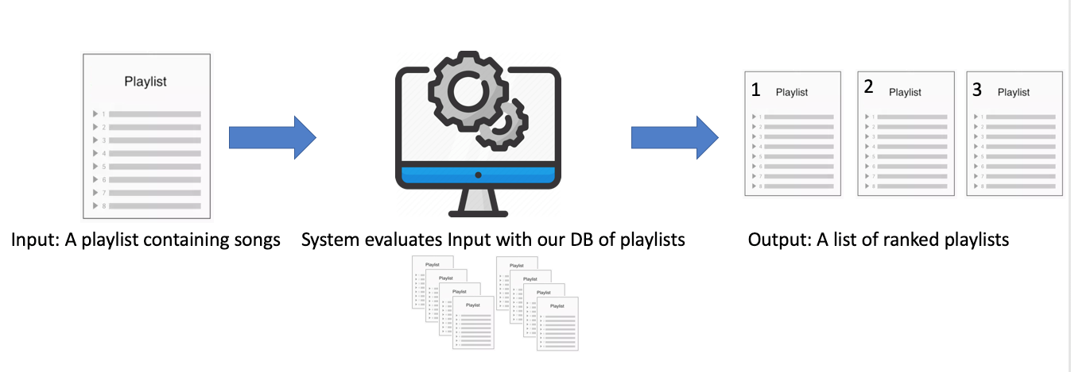
High Level Overview

Slide 4
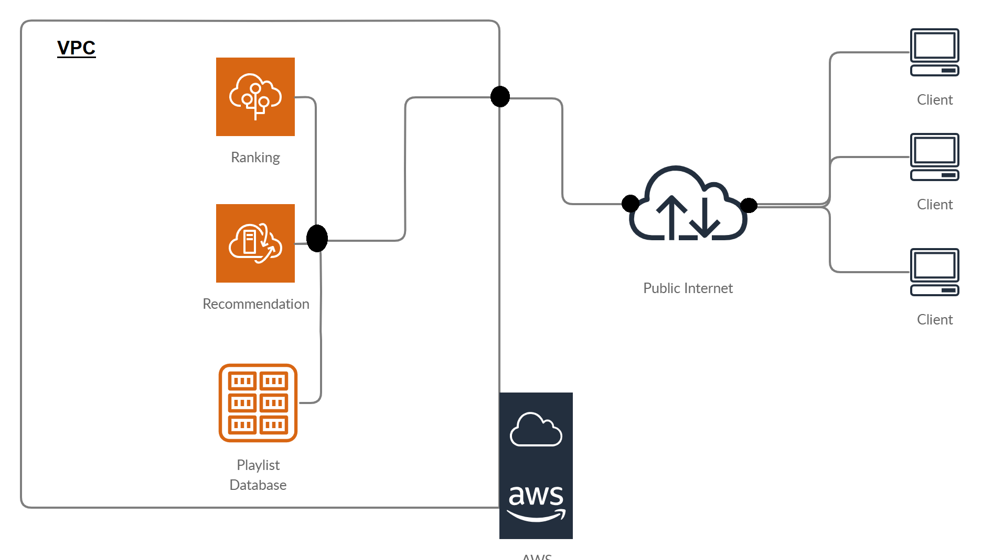
High Level Implementation

Slide 5
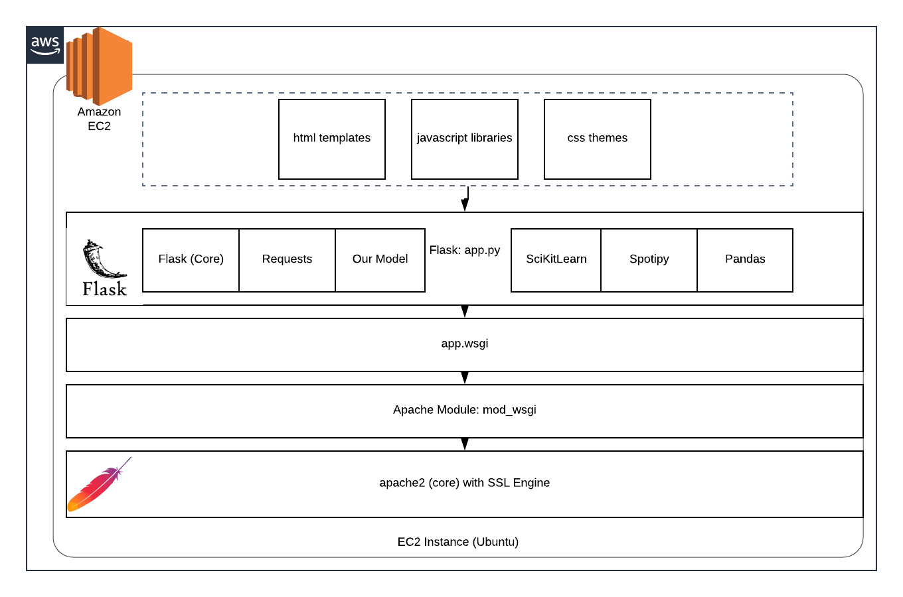
AWS Deployment
https://www.spotifyplaylistrecommender.ml/
Notes:
https://open.spotify.com/playlist/5Is7WWieaLqwfJ8H7CkcOh?si=a6PNhxDLTqmA22-LooolqQ

Slide 6

Challenges

Slide 7
Challenges
Given the time constraint and data collection methodology, we have the following challenges:
Data collection:
Survey Monkey?
In Person survey?
- Cold start Problem: how to deal with data without history
- AWS security, Palo Alto Firewall?
- Data Sparsity: Some data is not rated by the users,
- Feature extraction where some songs doesn’t have features to extract
- Synonymy: songs with the same names with different features!
- Evaluation system, direct feedback!

Slide 8
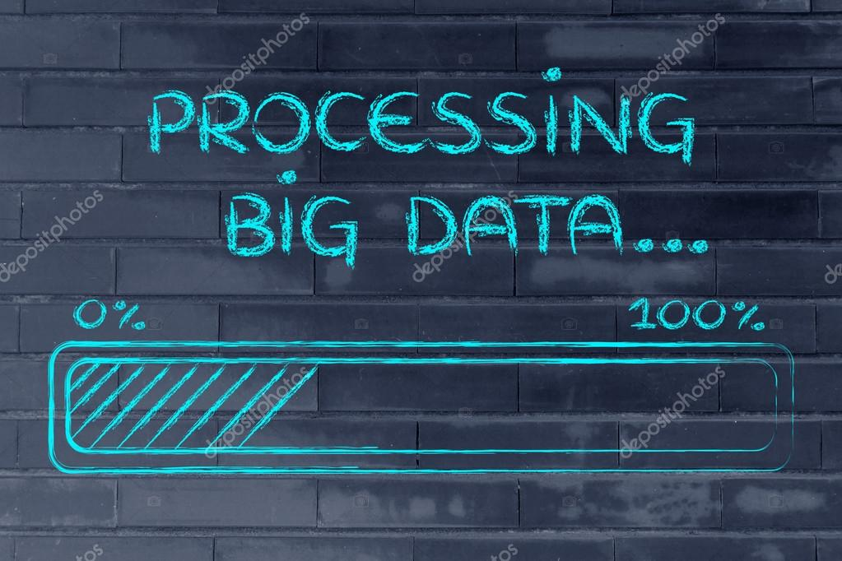
Data Characteristics and Processing

Slide 9
Data mining and processing
Steps we follow to process data:
1- Acquiring Data - List of Playlists
2- Preparing Data - For each playlist query track details - Feature Extraction
3- Analyze - Apply RS models.
4- Report and Act - Create App and collect user feedback.

Slide 10
Required Data’s Characteristic
Unique playlists
Relatively recent playlists and tracks
Clean out invalid (broken or non-spotify) playlist links
Remove irrelevant album, podcast, etc. data.
Split the data in slice of 1000 playlists and store as accessible json.zip files.
Notes:
Features
Danceablity and other features

Slide 11
Acquiring Data
We first formulate the problem we need to solve
Identify ways to collect data
In-Person survey - Ask friends for playlists.
Survey Monkey - Get a list of playlist IDs.
Link for our survey “https://www.surveymonkey.com/r/CY7DL9D”
Use our own Data - Create our own playlists.
Scrape publicly available Data - Twitter and Reddit posts
4k mpd + 5.4k Reddit + 1.8k User = 11,000+ playlists
Extract features - Use Spotify API to get specific playlist tracks, and track details.
Move to the next step, integration and storing data
Collect all playlists and associated tracks in json format and store compressed json.zip file.

Slide 12
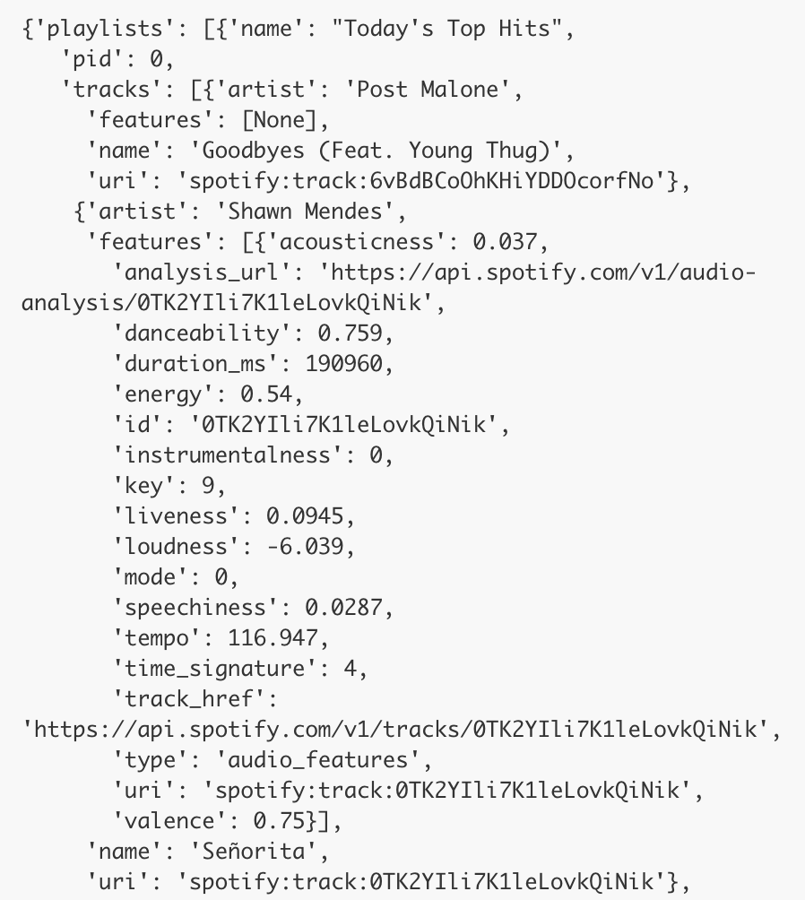
Sample of Playlist Features
Playlist Level Info
Owner
Creation Date
Number of tracks
Track Level Info
Title
Artists
Album Info
Acoustic Features
Spotify’s REST API allows for more metadata/insights
GET https://api.spotify.com/v1/audio-features/{id}

Slide 13
Acoustic Features
duration_ms | int | Duration of tracks in ms
key | int | Overall track : Pitch -> Int mapping eg. C# = 1
mode | 0,1 | Modality : Major or minor
time_signature | int | Meter of track : #beats in each bar
acousticness | [0.0,1.0] | Confidence measure whether track is acoustic
danceability | [0.0,1.0] | Combination of tempo, rhythm stability, beat strength, overall regularity
energy | [0.0,1.0] | Perceptual measure of intensity and activity
instrumentalness | [0.0,1.0] | Predicts whether track contains vocals or not.
Others : Liveliness (audience), loudness (dB), speechiness. valence (positiveness), tempo(bpm)
Also available is auto analysis - pitches, timbre, bars, beats, tactum - at the start, overall, end of the track - We didn’t consider this.. Too heavy.

Slide 14

How to approach this problem

Slide 15
How to approach this problem
Users have manually created millions of playlists.
We will collect public playlists and its tracks using Spotify API
Collect acoustic features of each track to use while computing playlist similarity.
Use a hybrid of Collaborative (tracks present together in another playlist) and Content based (track feature similarity) Recommendation.
Given a playlist, predict the most similar playlists.

Slide 16
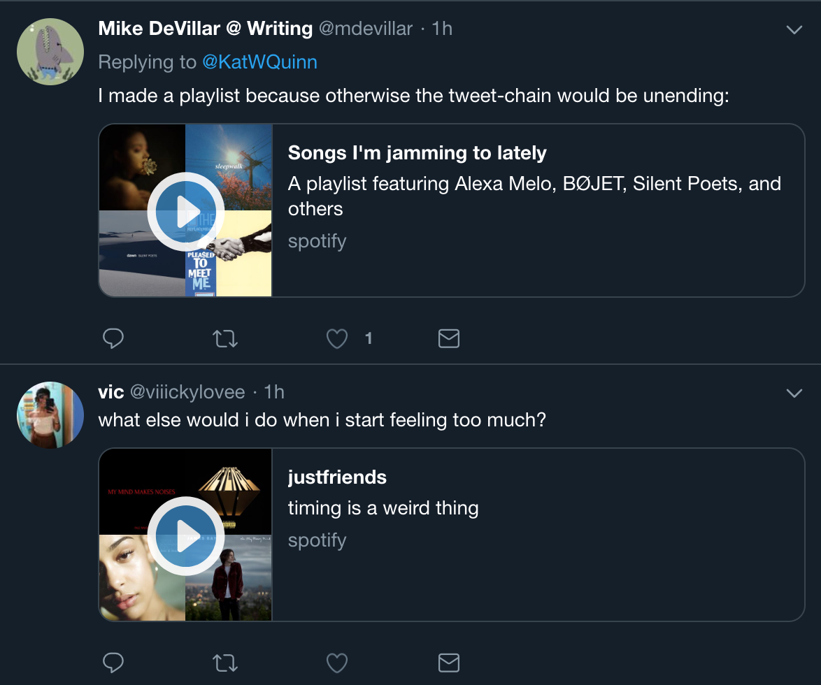
Scraping Data
People like sharing what they’re listening to on social sites like Twitter/Reddit
Used Twitter and Reddit’s REST Api to fetch instances of Spotify Playlist URLs
The pattern to look for is ‘open.spotify.com/playlist/<playlist id>’
Scraped ~11k playlists after filtering dupes amounting to 2.2GB worth of data

Slide 17
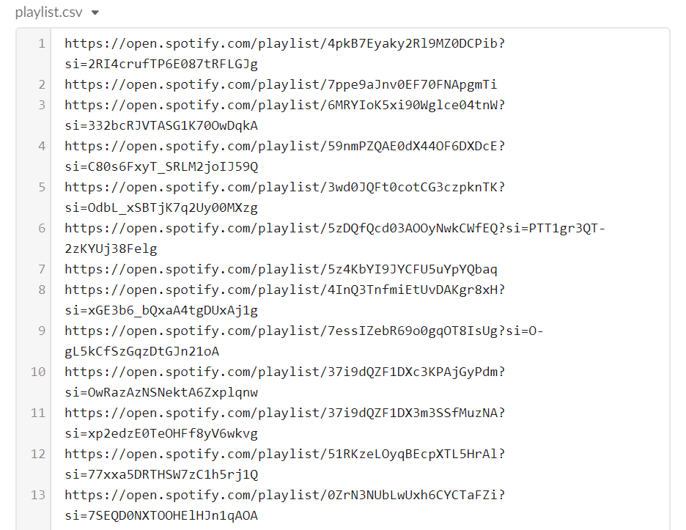
Scraped Data Sample

Slide 18
Prepare Data
Explore Data: Perform preliminary analysis to get insights in the the dataset and identify any issues
Preprocess data:
Data Cleaning (remove duplicates, empty playlists, empty track details.)
Feature extraction or selection (use Spotify API for acoustic features of tracks)

Slide 19
Analyze Data and Report/Act
Analyze Data:
Select appropriate algorithms
Train/Build our model
Evaluate our model, algorithm, and parameter selection
Report :
Generate reports and visualization result like plots
Share the result - Most similar playlists

Slide 20

Solution & Implementation Methodology

Slide 21
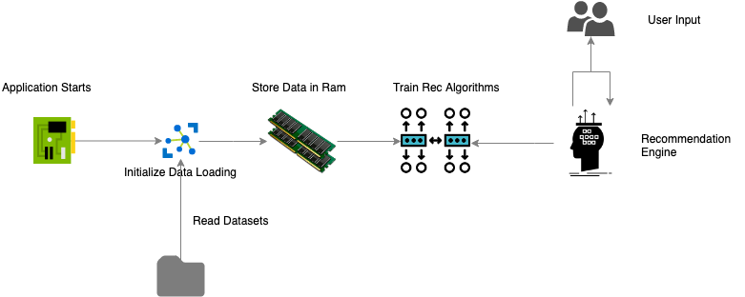
Simple Implementation Diagram

Slide 22
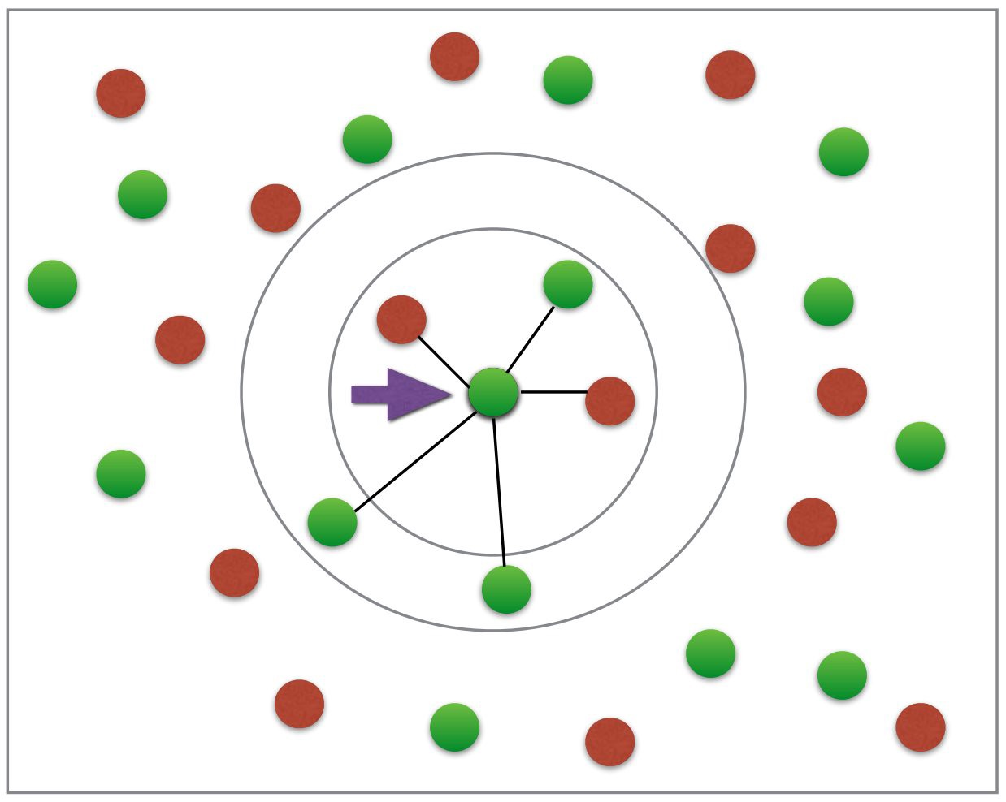
Playlist based Nearest-Neighbor
self.playlist_features = ['danceability', 'energy', 'loudness', 'speechiness', 'acousticness', 'liveness', 'valence', 'tempo']
self.model_knn = NearestNeighbors(metric='cosine', algorithm='brute', n_neighbors=10, n_jobs=-1)
self.model_knn.fit(df_data, axis=1))
distances, indices = self.model_knn.kneighbors(df_user, 10)
Song’s features are averaged
Input Playlist

Slide 23
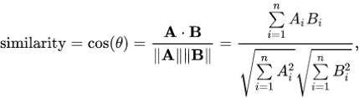
Playlist based Cosine Similarity
from sklearn.metrics.pairwise import cosine_similarity
self.playlist_features = ['danceability', 'energy', 'loudness', 'speechiness', 'acousticness', 'liveness', 'valence', 'tempo']
rec_matrix = cosine_similarity(df_user, df_data,, axis=1))
# sort list descending (top similar first) rec_index_list = (-rec_matrix[0]).argsort()

Slide 24
What are we doing next?
Develop more complex algorithms!
Store the model and data move efficiently
More diverse dataset
Add better filters
Notes:
TUMP

Slide 25
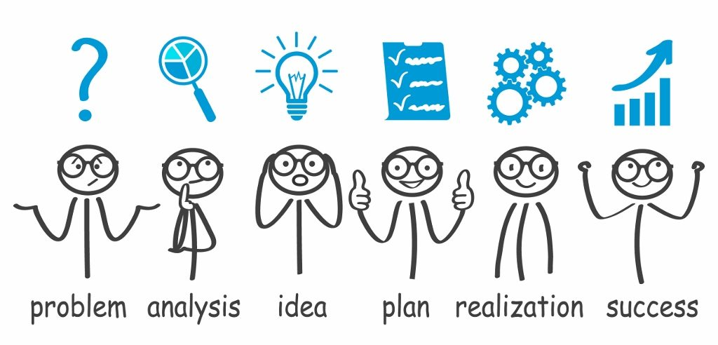
Solution Evaluation

Slide 26
Solution Evaluation
Compute score for a playlist based on assigned weights for a song category
Compute score for each playlist returned by recsys is within +/- threshold
Decrement score by weight for songs repeated in input playlist
Repeat the process for few multiple playlists of diverse in nature
Feedback collection system to improve recsys as per users likes / dislikes

Slide 27
Expected Impact
Recommendations to improve as user engagement with platform grow
As users in the platform grows, possibility to implement hybrid recsys
Evaluate the performance of recsys by changing parameters considered
Determine the right parameters to be considered for optimal match
Determine the size of dataset to be considered for optimal match

Slide 28

Thank You!

